Slide 1
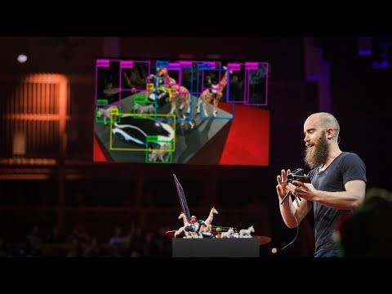
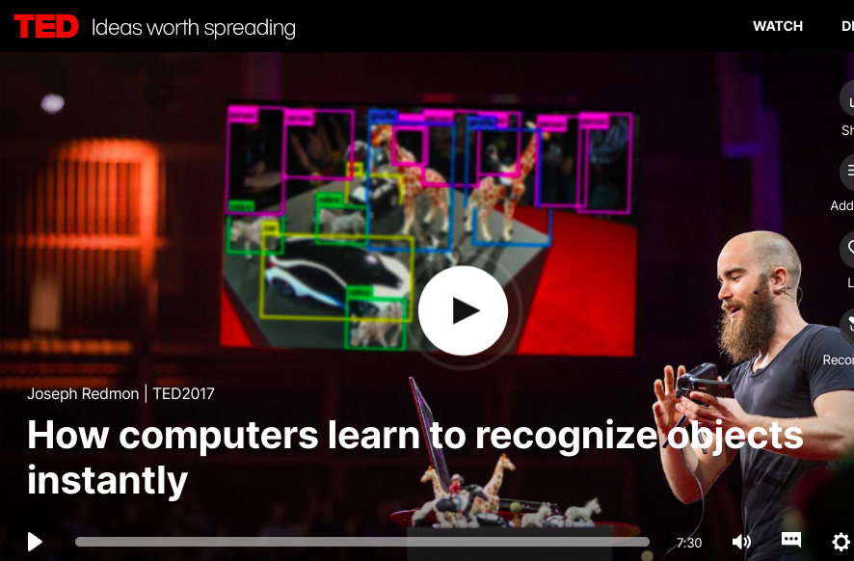


Computational vision: object detection
Petia Radeva
Petia Radeva

Slide 2
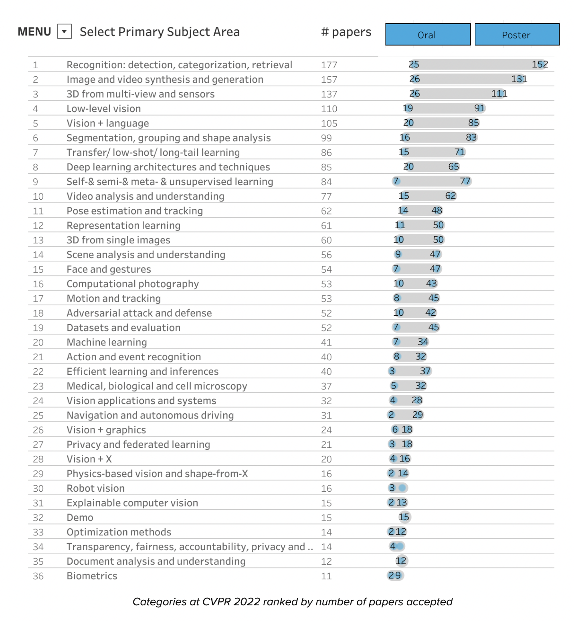
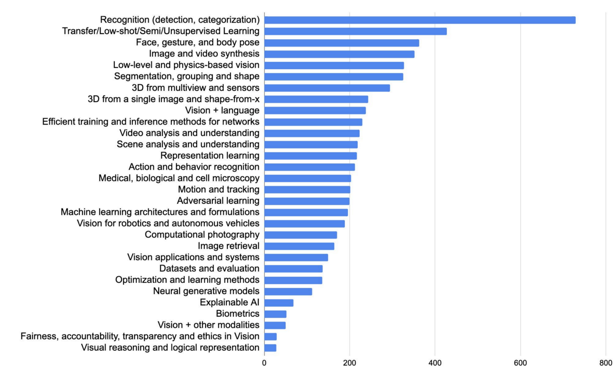
CVPR’2019 vs 2022

Slide 3
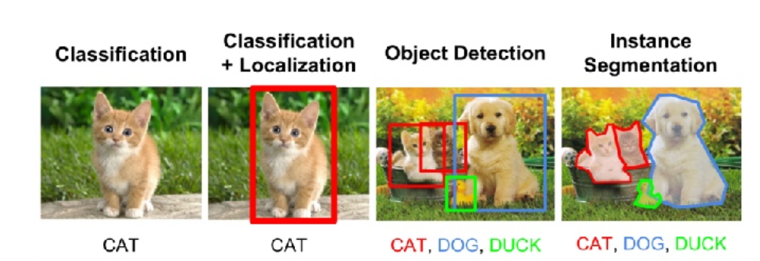
The concept of Object detection
Image classification
(what? I don’t care where)
Object detection
(what + where?)
Single object
Multiple objects

Slide 4
Object Detection
deer
cat
Notes:
Input: image
Output: object category and location for every object in the image

Slide 5
Object Detection
Class Scores
Deer: 0.9
Cat: 0.05
Umbrella: 0.01
…
Fully Connected:
4096 to k
Fully Connected:
4096 to 4
Box Coordinates
(x, y, w, h)

Slide 6
Object Detection
4096
Deer: (x, y, w, h)
Cat: (x, y, w, h)

Slide 7
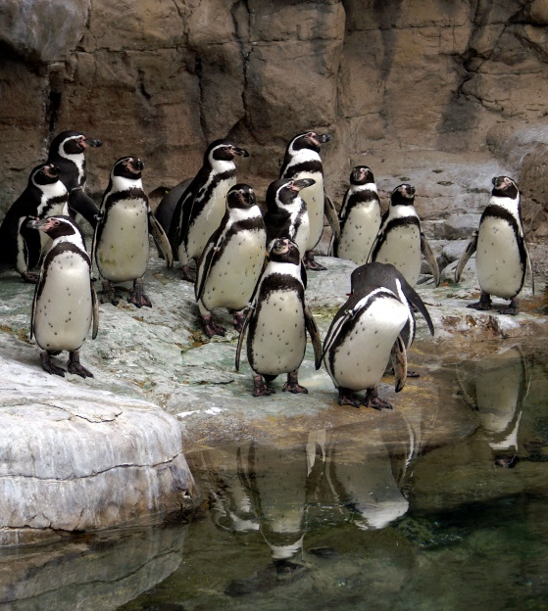
Object Detection
Penguin: (x, y, w, h)
Penguin: (x, y, w, h)
Penguin: (x, y, w, h)
Penguin: (x, y, w, h)
…
4096

Slide 8
Object Detection as Classification
deer?
CNN
cat?
background?

Slide 9
Object Detection as Classification
deer?
CNN
cat?
background?

Slide 10
Object Detection as Classification
deer?
CNN
cat?
background?

Slide 11
Object Detection as Classification with Sliding Window
deer?
CNN
cat?
background?
Notes:
Main idea:

Slide 12
Object Detection as Classification with Box Proposals

Slide 13
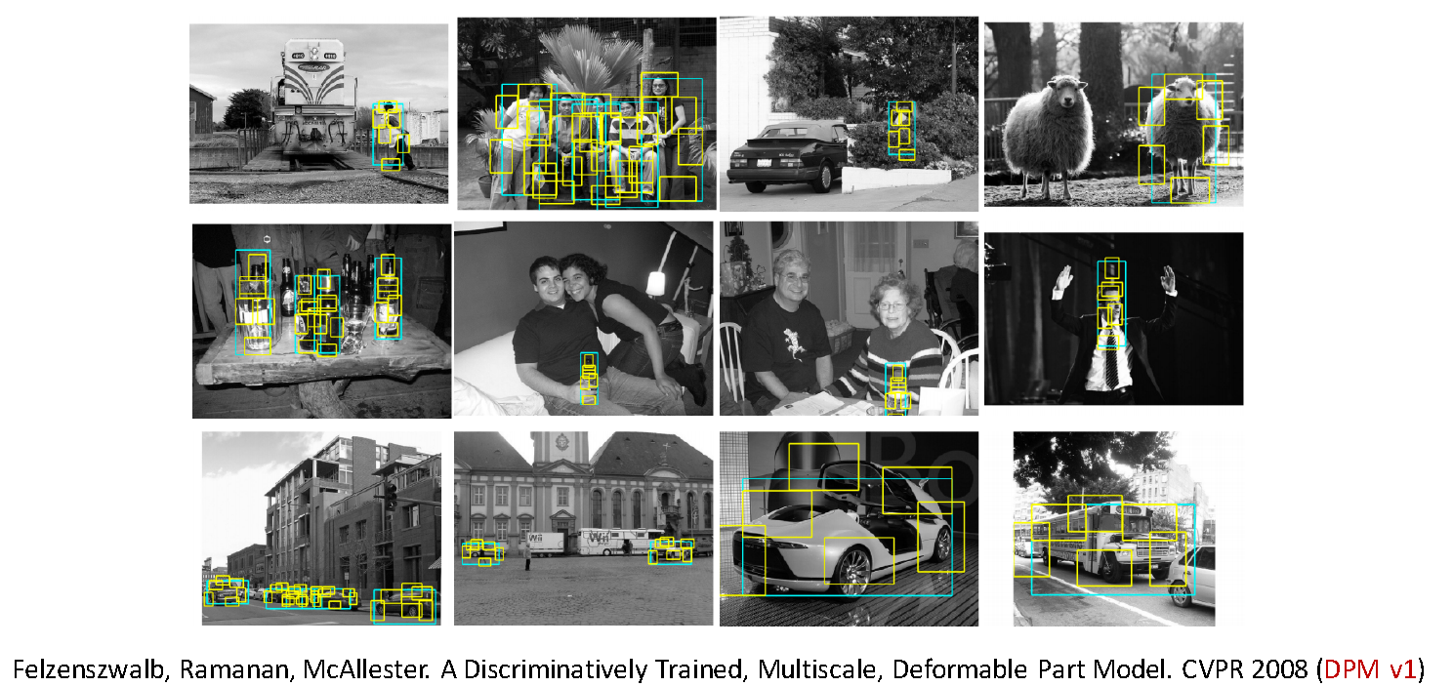
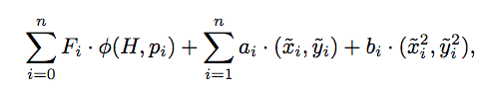
Object detection circa 2007
Based on HOG, deformable model representing different parts and a SVM classifier:

Slide 14
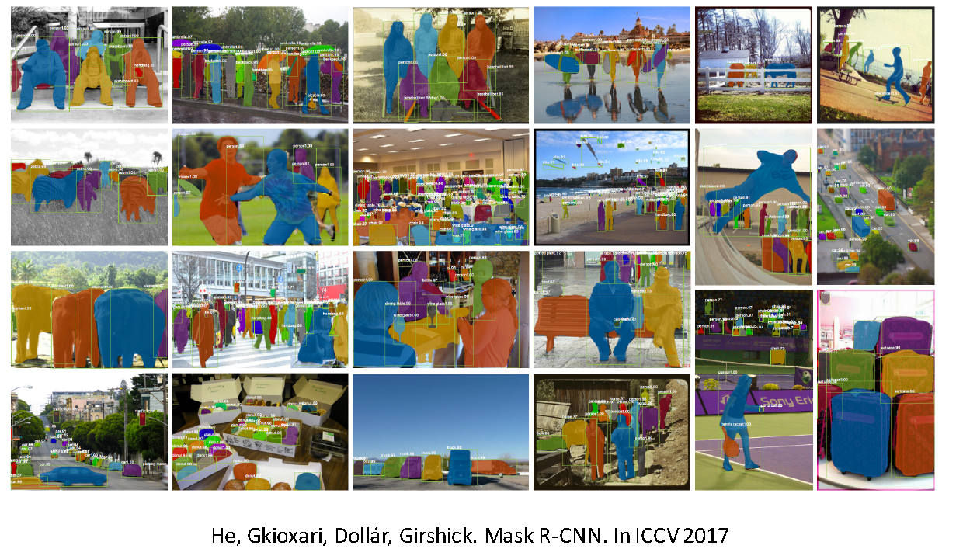
Object detection today is based on Deep learning

Slide 15
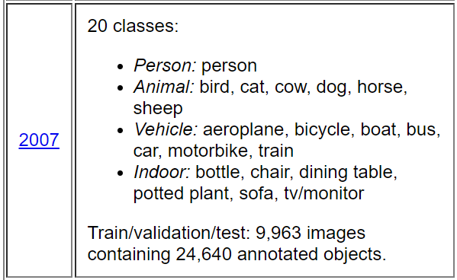
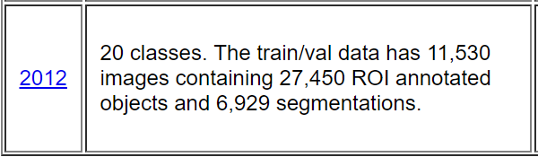

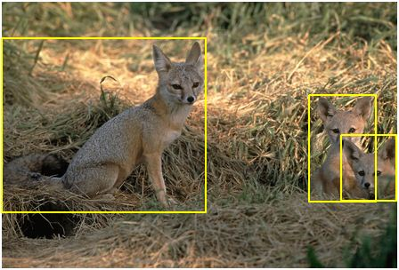
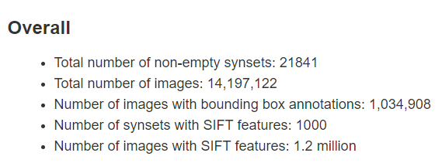
Datasets for Object detection
ImageNet is an image dataset organized according to the WordNet hierarchy.
Each meaningful concept in WordNet, possibly described by multiple words or word phrases, is called a "synonym set" or "synset“.
Average of 1000 images for every synset : in every image there is only one object.
Notes:
Synset is a special kind of a simple interface that is present in NLTK to look up words in WordNet. Synset instances are the groupings of synonymous words that express the same concept. Some of the words have only one Synset and some have several.

Slide 16

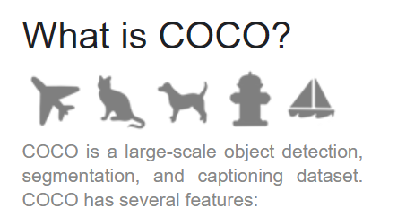
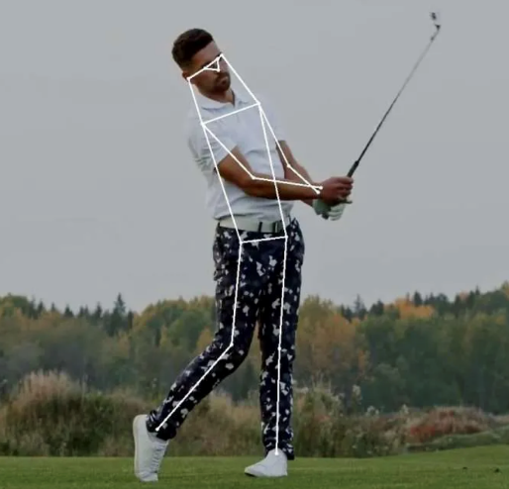
Datasets for Object detection (2014)
80 object categories
330K images (>200K labelled)
Recognition in context
Object segmentation
Super-pixel stuff segmentation
1.5 million object instances
91 stuff categories
5 captions per image
250,000 people with key-points

Slide 17
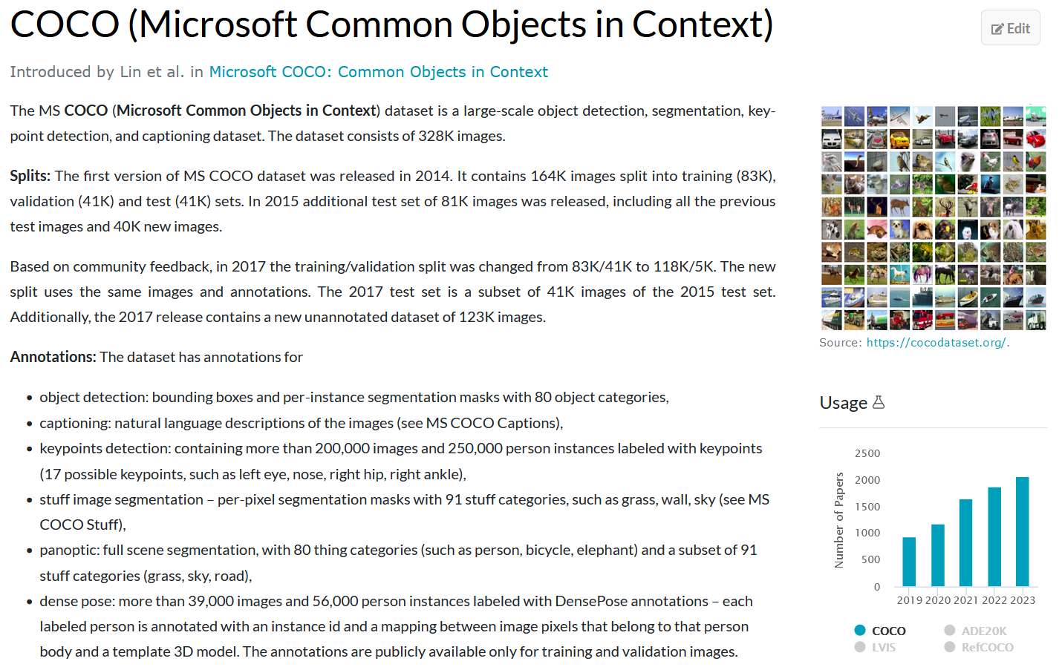
MS COCO

Slide 18
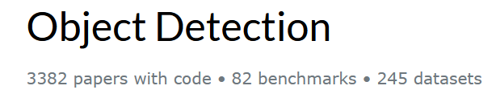
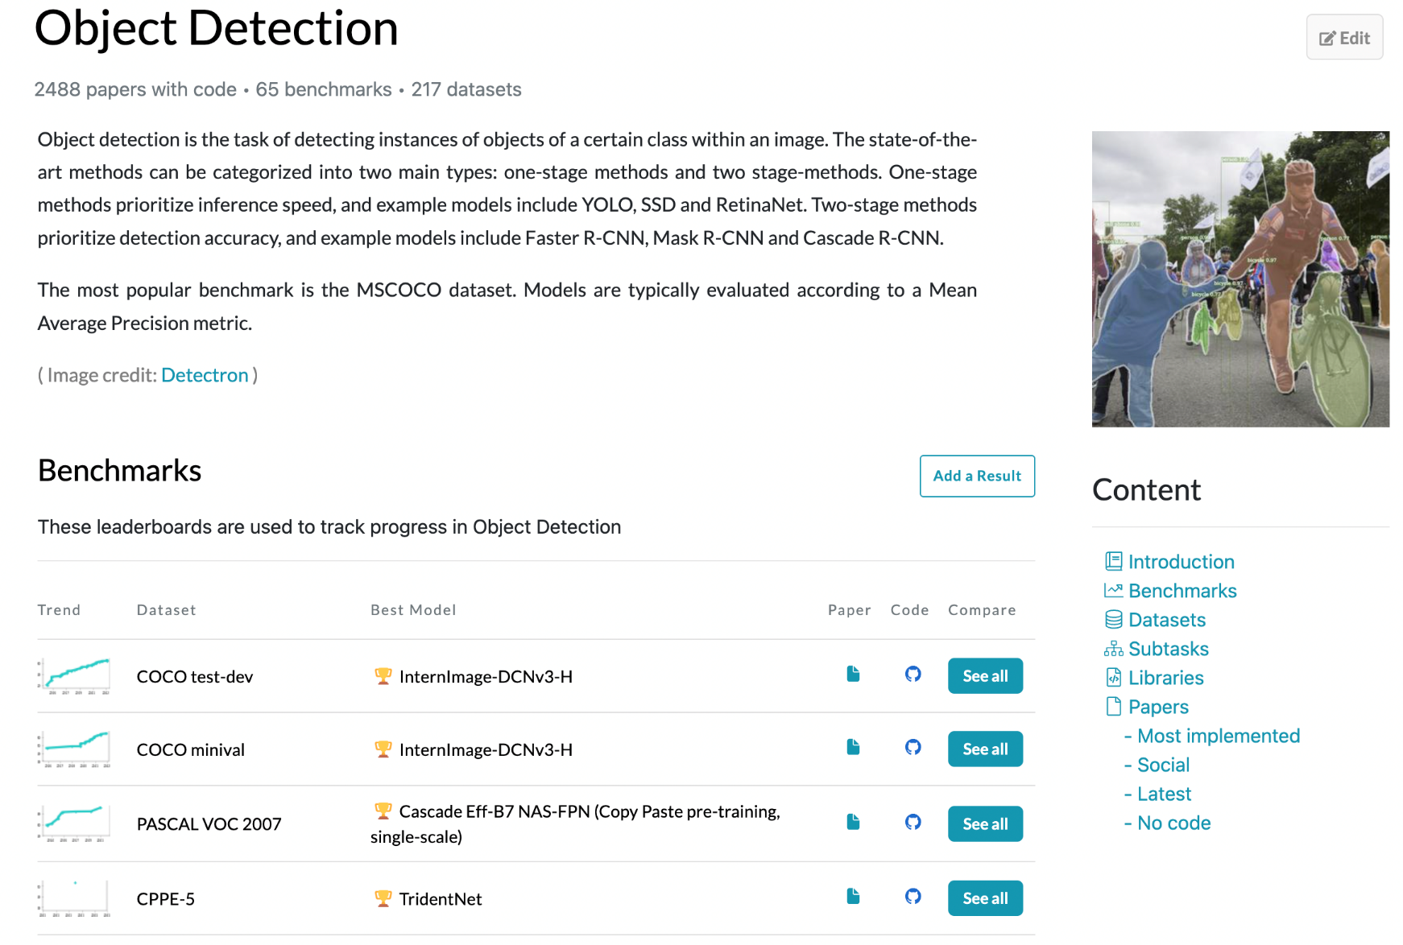
Paperswithcode

Slide 19
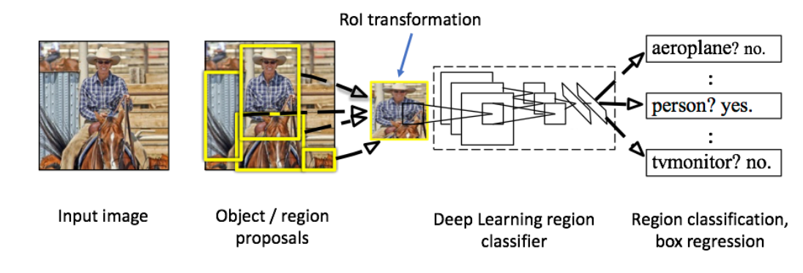
2014: R-CNN - An Early Application of CNNs to Object Detection
To what extent do CNN generalize to object detection?
Recognition using regions paradigm
Girshick, Ross, et al. "Rich feature hierarchies for accurate object detection and semantic segmentation." Proceedings of the IEEE conference on computer vision and pattern recognition. 2014.
Notes:
https://www.learnopencv.com/selective-search-for-object-detection-cpp-python/

Slide 20
2014: R-CNN - An Early Application of CNNs to Object Detection
R-CNN combines region proposals with CNNs:
applying high-capacity convolutional neural networks (CNNs) to bottom-up region proposals in order to localize objects,
when labelled training data is scarce, supervised pre-training for an auxiliary task, followed by domain-specific fine-tuning, yields a significant performance boost.
Girshick, Ross, et al. "Rich feature hierarchies for accurate object detection and semantic segmentation." Proceedings of the IEEE conference on computer vision and pattern recognition. 2014.
Notes:
https://www.learnopencv.com/selective-search-for-object-detection-cpp-python/
Two properties make detection efficient. First, all CNN parameters are shared across all categories. Second, the feature vectors computed by the CNN are low-dimensional when compared to other common approaches, such as spatial pyramids with bag-of-visual-word encodings.

Slide 21
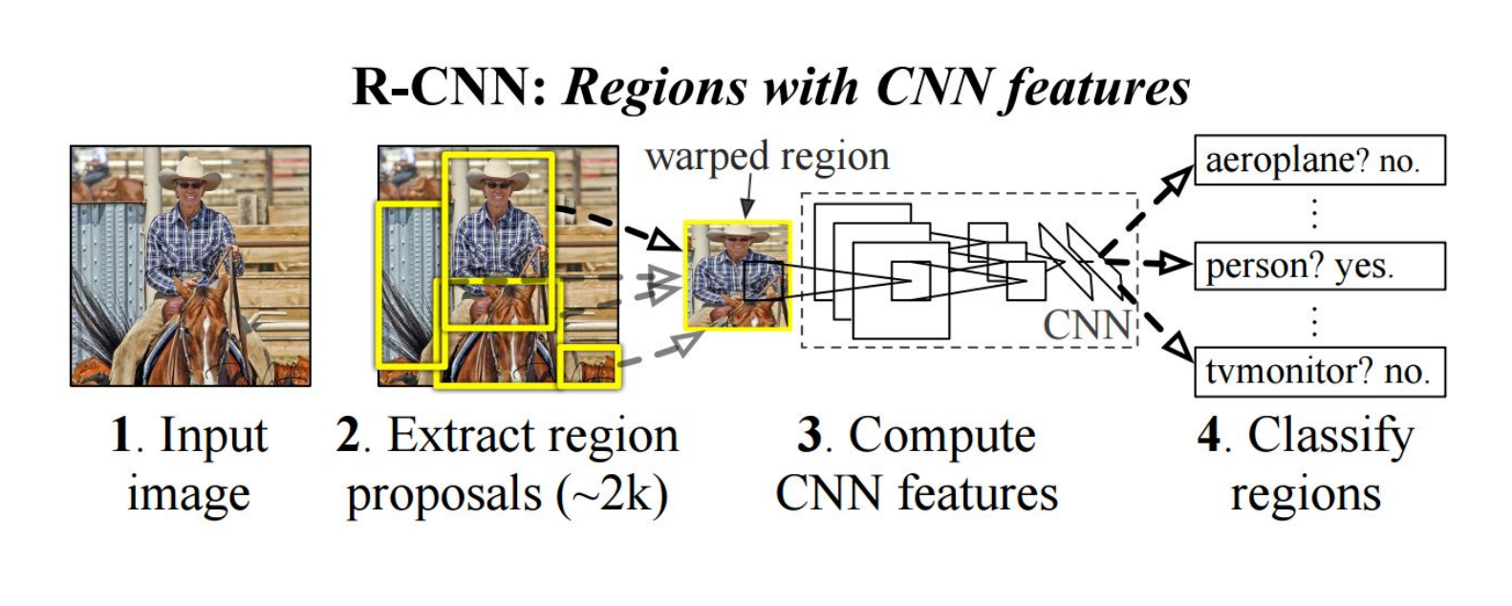
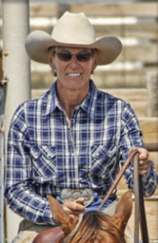
R-CNN
First stage: generate category-independent region proposals.
2000 Region proposals for every image
Second stage: extracts a fixed-length feature vector from each region.
feature vector
people?
linear
svm
horse?
a 4096-dimensional feature vector from each region proposal
background?
Bounding box regression
x
y
w
h
Third stage: a set of class- specific linear SVMs.
proposal location
object category and location
Notes:
On the one hand, use the image structure to guide the sampling process. On the other hand: aim to capture all possible object locations.

Slide 22
2014: R-CNN - An Early Application of CNNs to Object Detection
Inputs: Image
Outputs: Bounding boxes + labels for each object in the image.
Object detection system overview. The system:
(1) takes an input image,
(2) extracts around 2000 bottom-up region proposals,
(3) computes features for each proposal using a large convolutional neural network (CNN), and
(4) classifies each region using class-specific linear SVMs.
Notes:
Region proposal algorithms identify prospective objects in an image using superpixel segmentation. In segmentation, we group adjacent regions which are similar to each other based on some criteria such as color, texture etc. Unlike the sliding window approach where we are looking for the object at all pixel locations and at all scales, region proposal algorithm work by grouping pixels into a smaller number of segments. So the final number of proposals generated are many times less than sliding window approach. This reduces the number of image patches we have to classify. These generated region proposals are of different scales and aspect ratios.

Slide 23
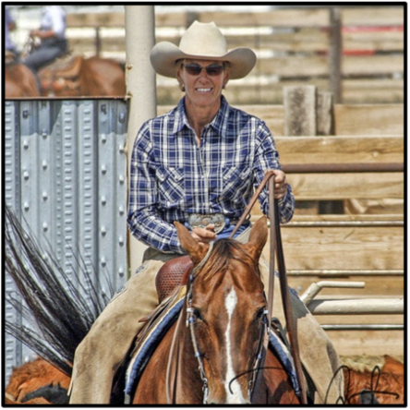
R-CNN
First stage: generate category-independent region proposals.
2000 Region proposals for every image
Affine image warping to compute a ﬁxed-size CNN output (4096-dim) from each region proposal, regardless of the region’s shape.
Notes:
On the one hand, use the image structure to guide the sampling process. On the other hand: aim to capture all possible object locations.

Slide 24


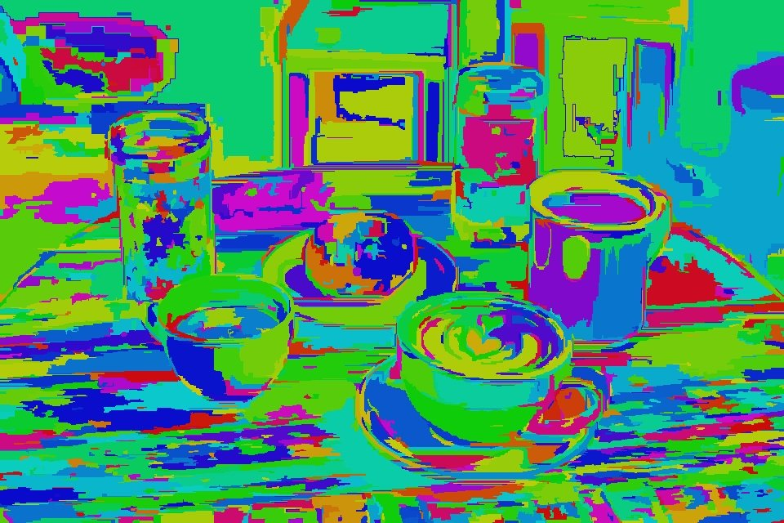
Selective Search for Object Recognition
Original Image
Segmented Image
Oversegmented Image
Region proposal algorithm used in object detection.
Fast with a very high recall.
Based on computing hierarchical grouping of similar regions based on colour, texture, size and shape compatibility.
Notes:
Selective Search is a region proposal algorithm used in object detection. It is designed to be fast with a very high recall. It is based on computing hierarchical grouping of similar regions based on color, texture, size and shape compatibility.
Selective Search starts by over-segmenting the image based on intensity of the pixels using a graph-based segmentation method by Felzenszwalb and Huttenlocher. The output of the algorithm is shown below. The image on the right contains segmented regions represented using solid colors.

Slide 25
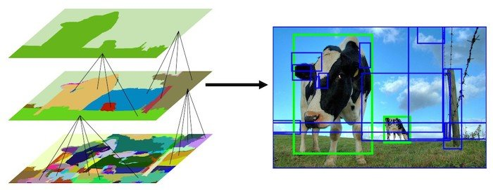
Selective Search for Object Recognition
“Hierarchical” segmentations using Felzenszwalb and Huttenlocher’s oversegments.
Selective Search algorithm takes these oversegments as initial input and performs:
Add all bounding boxes corresponding to segmented parts to the list of regional proposals
Group adjacent segments based on similarity
Go to step 1
At each iteration, larger segments are formed and added to the list of region proposals in a bottom-up approach.
Notes:
Selective Search algorithm takes these oversegments as initial input and performs the following steps
Add all bounding boxes corresponding to segmented parts to the list of regional proposals
Group adjacent segments based on similarity
Go to step 1
At each iteration, larger segments are formed and added to the list of region proposals. Hence we create region proposals from smaller segments to larger segments in a bottom-up approach. This is what we mean by computing “hierarchical” segmentations using Felzenszwalb and Huttenlocher’s oversegments.

Slide 26
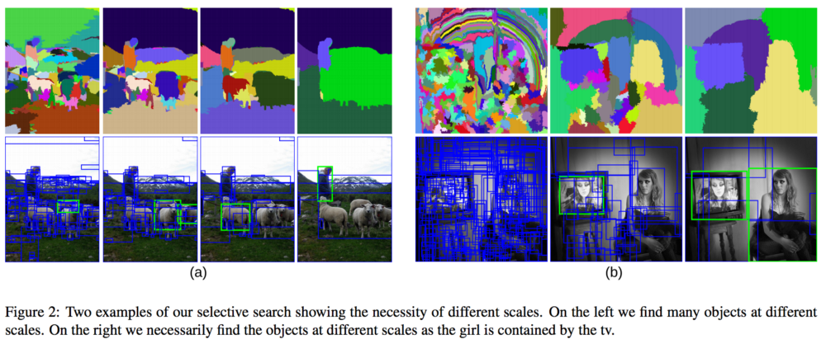
R-CNN: First module - Region proposal: selective search
Results
Notes:
To bypass the problem of selecting a huge number of regions, Ross Girshick et al. proposed a method where we use selective search to extract just 2000 regions from the image and he called them region proposals. Therefore, now, instead of trying to classify a huge number of regions, you can just work with 2000 regions. These 2000 region proposals are generated using the selective search algorithm which is written below.
Selective Search: 1. Generate initial sub-segmentation, we generate many candidate regions 2. Use greedy algorithm to recursively combine similar regions into larger ones 3. Use the generated regions to produce the final candidate region proposals

Slide 27
R-CNN
Second stage: extracts a fixed-length feature vector from each region.
feature vector
warp
CNN
a 4096-dimensional feature vector from each region proposal
Arbitrary rectangles?
A fixed size input? 227 x 227
5 conv layers + 2 fully connected layers
Notes:
On the one hand, use the image structure to guide the sampling process. On the other hand: aim to capture all possible object locations.

Slide 28
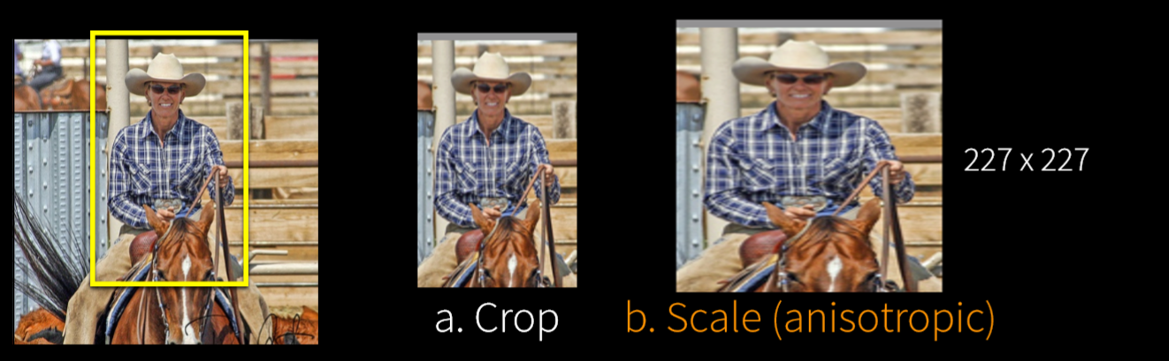
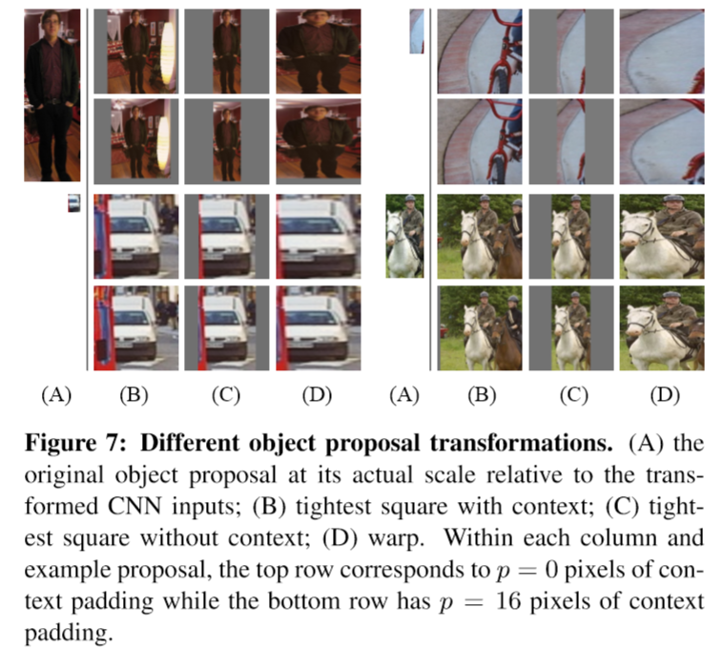
R-CNN: Object proposal transformations
Convolutional neural network requires a ﬁxed-size input of 227 × 227 pixels
(Pre-trained on Imagenet for image classification)
Prior to warping, dilate the tight bounding box so that at the warped size there are exactly p pixels of warped image context around the original box (we use p = 16)
A pilot set of experiments showed that warping with context padding (p = 16 pixels) outperformed the alternatives by a large margin

Slide 29
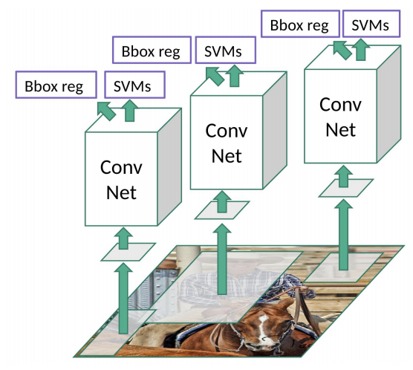
R-CNN: Third module – Feature classification/detection
Notes:
To know more about the selective search algorithm, follow this link. These 2000 candidate region proposals are warped into a square and fed into a convolutional neural network that produces a 4096-dimensional feature vector as output. The CNN acts as a feature extractor and the output dense layer consists of the features extracted from the image and the extracted features are fed into an SVM to classify the presence of the object within that candidate region proposal. In addition to predicting the presence of an object within the region proposals, the algorithm also predicts four values which are offset values to increase the precision of the bounding box. For example, given a region proposal, the algorithm would have predicted the presence of a person but the face of that person within that region proposal could’ve been cut in half. Therefore, the offset values help in adjusting the bounding box of the region proposal.

Slide 30
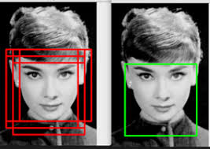

R-CNN: Third module – Feature classification/detection
Classify the feature of each region using category specific linear SVMs
For each class, score each extracted feature vector using the SVM trained for that class.
Given all scored regions in an image, apply a greedy non-maximum suppression (for each class independently) that rejects a region if it has an intersection-over union (IoU) overlap with a higher scoring selected region larger than a learned threshold.
IoU overlap threshold, below which regions are defined as negatives examples for the SVM
Timing (detection): 47/s image on GPU
Notes:
To know more about the selective search algorithm, follow this link. These 2000 candidate region proposals are warped into a square and fed into a convolutional neural network that produces a 4096-dimensional feature vector as output. The CNN acts as a feature extractor and the output dense layer consists of the features extracted from the image and the extracted features are fed into an SVM to classify the presence of the object within that candidate region proposal. In addition to predicting the presence of an object within the region proposals, the algorithm also predicts four values which are offset values to increase the precision of the bounding box. For example, given a region proposal, the algorithm would have predicted the presence of a person but the face of that person within that region proposal could’ve been cut in half. Therefore, the offset values help in adjusting the bounding box of the region proposal.

Slide 31
R-CNN - An Early Application of CNNs to Object Detection (2014)
Inputs: Image
Outputs: Bounding boxes + labels for each object in the image.
Test time:
A simple bounding box regression method signiﬁcantly reduces mislocalizations, which are the dominant error mode.

Slide 32
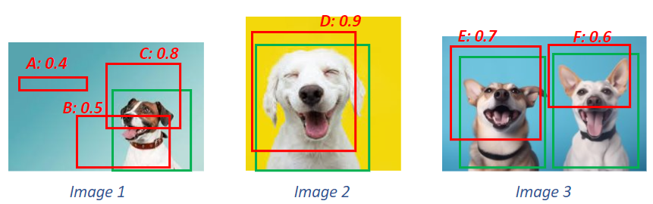
How to validate it? What is the mean Average Precision (mAP)?

Slide 33
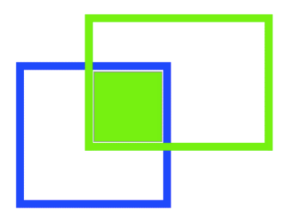
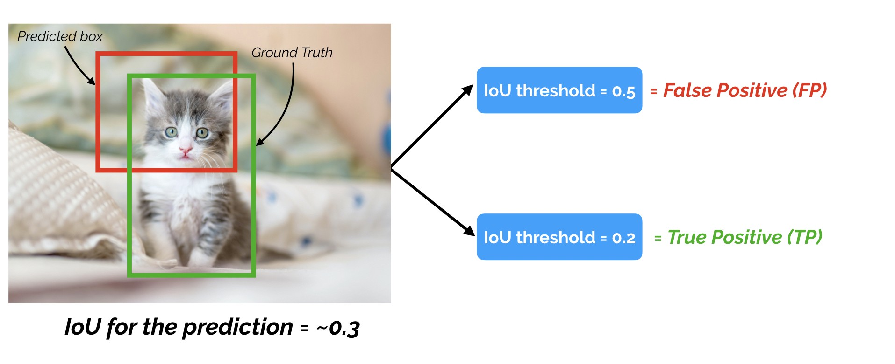
How to validate it? What is the mean Average Precision (mAP)?
What parameters shell a detection depend on?
Let us consider the Intersection of Union (IoU):
Picking the right single threshold for the IoU metric seems arbitrary.
One researcher might justify a 60 percent overlap, and another is convinced that 75 percent seems more reasonable.
So why not having all of the thresholds considered in a single metric?

Slide 34
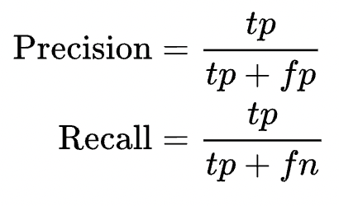
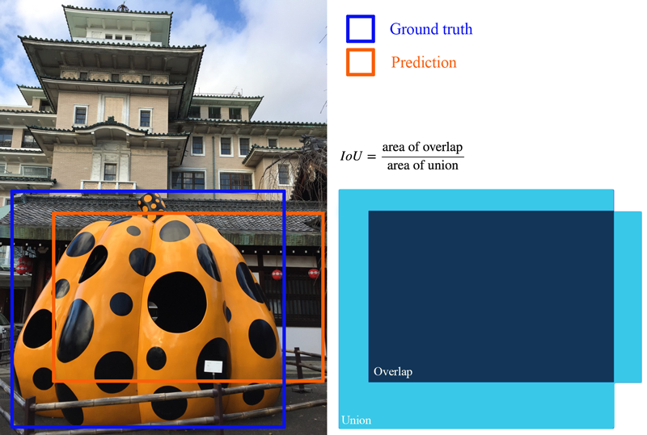
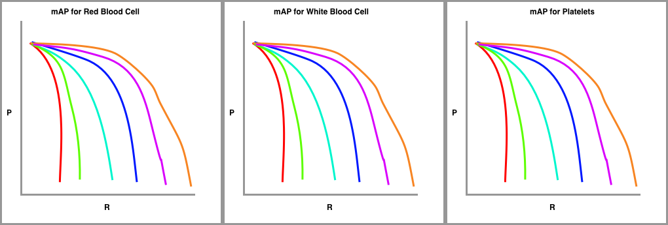
What is the mAP?
Draw a precision recall curve by considering different confidence levels
Draw a series of precision recall curves with the IoU threshold set at varying levels of difficulty (90%, 80%, etc).

Slide 35
What is the mAP?
Draw a precision recall curve by considering different confidence level
Draw a series of precision recall curves with the IoU threshold set at varying levels of difficulty (90%, 80%, etc).
A sketch of mAP by object class
mAP metrics calculates the average precision (AP) for each class individually across all of the IoU thresholds.
Then the metric averages the mAP for all classes to arrive at the final estimate.

Slide 36
Problems with R-CNN
It still takes a huge amount of time to train and run the network as you would have to classify 2000 region proposals per image.
It cannot be implemented real time as it takes around 47 seconds for each test image.
The selective search algorithm is a fixed algorithm. Therefore, no learning is happening at that stage. This could lead to the generation of bad candidate region proposals.

Slide 37
2015: Fast R-CNN - Speeding up and Simplifying R-CNN
R-CNN works really well, but is really quite slow for a few simple reasons:
It requires a forward pass of the CNN (AlexNet) for every single region proposal for every single image (that’s around 2000 forward passes per image!), without sharing computation.
It has to train three different models separately - the CNN to generate image features, the classifier that predicts the class, and the regression model to tighten the bounding boxes. This makes the pipeline extremely hard to train.
Intuition: run the CNN just once per image and then find a way to share that computation across the ~2000 proposals

Slide 38
RCNN
RCNN
Fast-RCNN
Simple and scalable.
Improves mAP.
A multistage pipeline.
Training is expensive in space and time (features are extracted from each region proposal in each image and written into disk).
Object detection is slow.
?

Slide 39
2015: Fast R-CNN - Speeding up and Simplifying R-CNN
Input: an entire image and a set of object proposals
The network ﬁrst processes the whole image with several convolutional (conv) and max pooling layers to produce a conv feature map.
Then, for each object proposal a region of interest (RoI) pooling layer extracts a ﬁxed-length feature vector from the feature map.
Notes:
The same author of the previous paper(R-CNN) solved some of the drawbacks of R-CNN to build a faster object detection algorithm and it was called Fast R-CNN. The approach is similar to the R-CNN algorithm. But, instead of feeding the region proposals to the CNN, it feeds the input image to the CNN to generate a convolutional feature map. From the convolutional feature map, it identifies the region of proposals and warp them into squares and by using a RoI pooling layer we reshape them into a fixed size so that it can be fed into a fully connected layer. From the RoI feature vector, we use a softmax layer to predict the class of the proposed region and also the offset values for the bounding box.
The reason “Fast R-CNN” is faster than R-CNN is because you don’t have to feed 2000 region proposals to the convolutional neural network every time. Instead, the convolution operation is done only once per image and a feature map is generated from it.

Slide 40
Fast-RCNN
Idea: No need to recompute features for every box independently
Fast R-CNN. Girshick. ICCV 2015. https://arxiv.org/abs/1504.08083

Slide 41
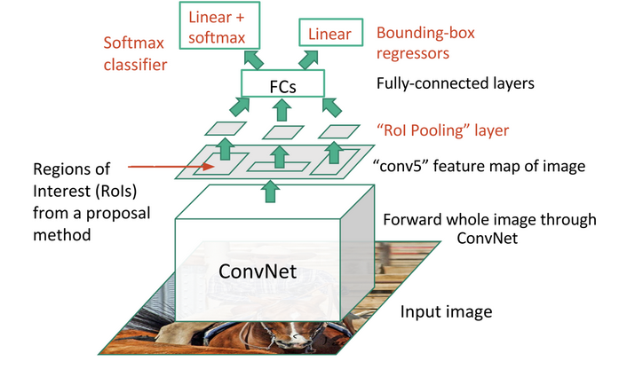
Fast-RCNN

Slide 42
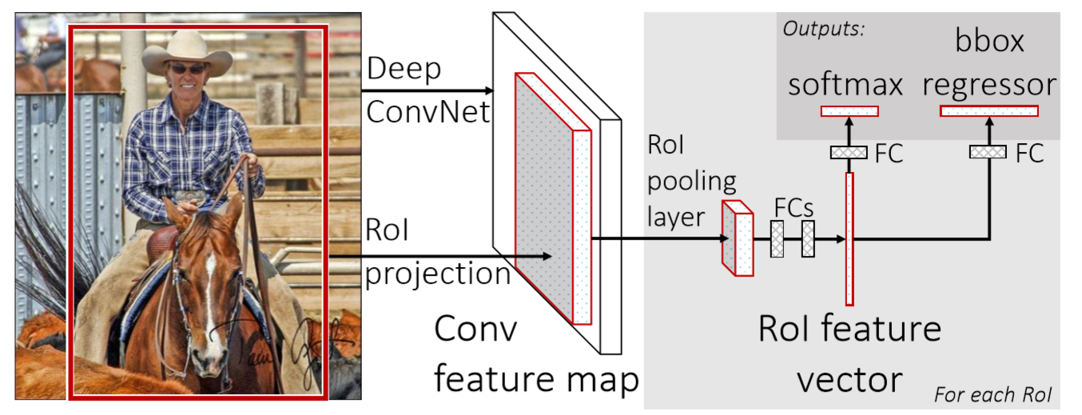
OUTPUTS
Fully connected (fc) layers elaborate feature vectors, that ﬁnally branch into two sibling output layers:
- softmax probability estimates over K object classes plus a catch-all “background” class
- another layer that outputs 4*K real-valued numbers: 4 for each of the K object classes.
Each set of 4 values encodes reﬁned bounding-box positions for one of the K classes.

Slide 43
OUTPUTS
Jointly train the CNN, classifier, and bounding box regressor in a single model:
Fast R-CNN replaced the one-vs-rest SVM classifiers with a softmax layer on top of the CNN to output a classification (introduce competition among classes).
It also adds a linear regression layer parallel to the softmax layer to output bounding box coordinates.

Slide 44
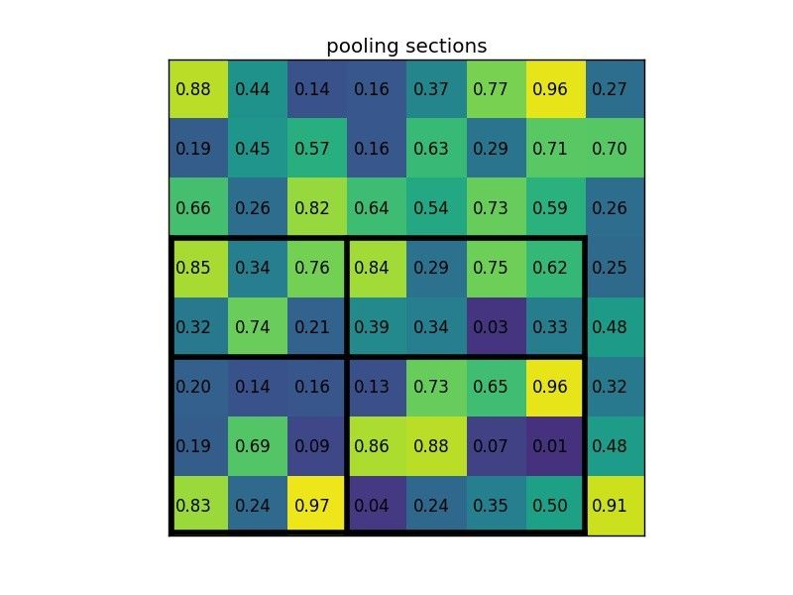
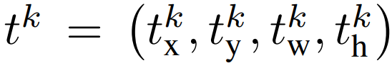
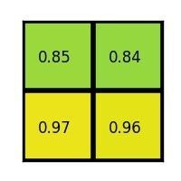
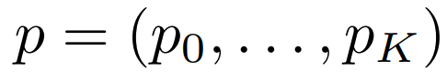
RoI pooling layer
Max pooling to convert the features inside any valid region of interest (region proposal) into a small feature map with a ﬁxed spatial extent of H ×W (layer hyper-parameters that are independent of any particular RoI. )
It works by dividing a h×w RoI window into an H × W grid of sub-windows of approximate size (h/H) × (w/W) and then max-pooling the values in each sub-window into the corresponding output grid cell

Slide 45
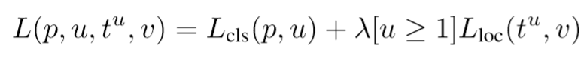
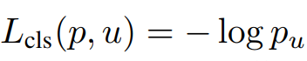
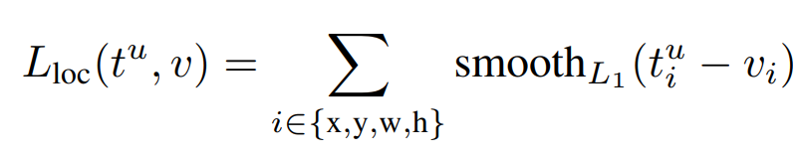
Multi-task loss
Background
As already stated, the outputs are:
a discrete probability distribution (per RoI) over K+1 categories
bounding-box regression offsets, for each of the K object classes
Each training RoI is labeled with a ground-truth class u and a ground-truth bounding-box regression target
Multi-task loss L on each labeled RoI to jointly train for classification and bounding-box regression:
also proved a task influence, so multitask help training

Slide 46
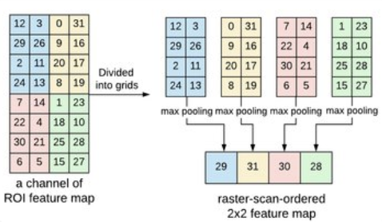
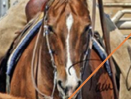
Fast-RCNN
Process the whole image with several convolutional (conv) and max pooling layers to produce a conv feature map.
a region of interest (RoI) pooling layer extracts a fixed-length feature vector from the region feature map.
FC+
softmax
K + 1 categories
feature vector
+
four real-valued numbers for each of the K object classes.
FC+
regressor
…

Slide 47
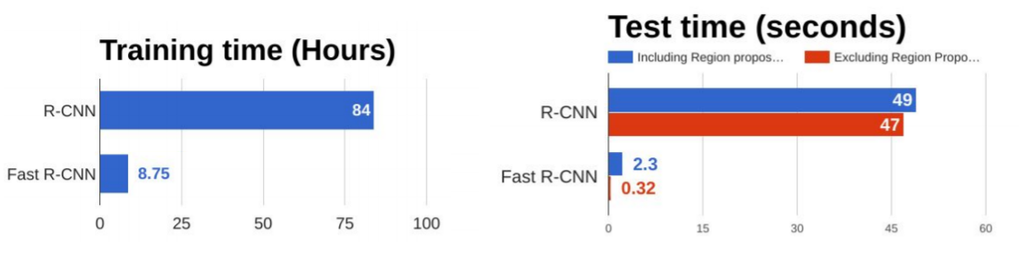
RCNN vs Fast-RCNN
Figure adapted from: http://cs231n.stanford.edu/slides/2017/cs231n_2017_lecture11.pdf
Notes:
https://towardsdatascience.com/r-cnn-fast-r-cnn-faster-r-cnn-yolo-object-detection-algorithms-36d53571365e
From the above graphs, you can infer that Fast R-CNN is significantly faster in training and testing sessions over R-CNN. When you look at the performance of Fast R-CNN during testing time, including region proposals slows down the algorithm significantly when compared to not using region proposals. Therefore, region proposals become bottlenecks in Fast R-CNN algorithm affecting its performance.

Slide 48
RCNN vs Fast-RCNN
RCNN
Fast-RCNN
Faster-RCNN
Simple and scalable.
improves mAP.
Higher mAP.
Single stage, end-to-end training.
No disk storage is required for feature caching.
A multistage pipeline.
Training is expensive in space and time (features are extracted from each region proposal in each image and written into disk).
Object detection is slow.
?
proposals are the computational bottleneck in detection systems.

Slide 49
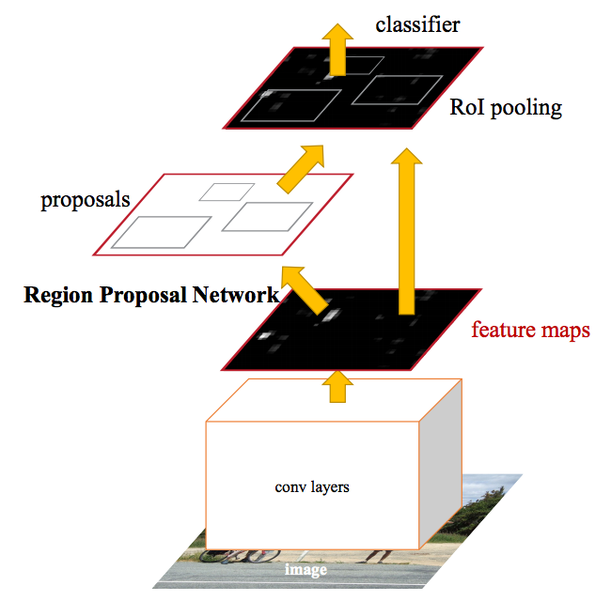
2016: Faster R-CNN - Speeding Up Region Proposal
One remaining bottleneck in the Fast R-CNN process - the region proposer, Selective search. Timing: 2 second per image on CPU implementation
Insight: convolutional feature maps used by region-based detectors, like Fast RCNN, can also be used for generating region proposals.
Faster R-CNN adds a Fully Convolutional Network on top of the features of the CNN creating what’s known as the Region Proposal Network.
Timing : 10ms per image for the proposal
Execution: 5 fps
Faster R-CNN

Slide 50


Most influential Google Scholar papers 2020

Slide 51
Faster-RCNN
Idea: Integrate the Bounding Box
Proposals as part of the CNN predictions
Ren et al. NIPS 2015. https://arxiv.org/abs/1506.01497
Notes:
Both of the above algorithms(R-CNN & Fast R-CNN) uses selective search to find out the region proposals. Selective search is a slow and time-consuming process affecting the performance of the network. Therefore, Shaoqing Ren et al. came up with an object detection algorithm that eliminates the selective search algorithm and lets the network learn the region proposals.
Similar to Fast R-CNN, the image is provided as an input to a convolutional network which provides a convolutional feature map. Instead of using selective search algorithm on the feature map to identify the region proposals, a separate network is used to predict the region proposals. The predicted region proposals are then reshaped using a RoI pooling layer which is then used to classify the image within the proposed region and predict the offset values for the bounding boxes.

Slide 52
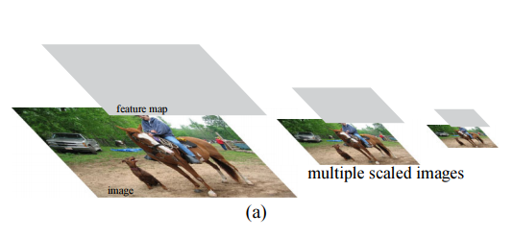
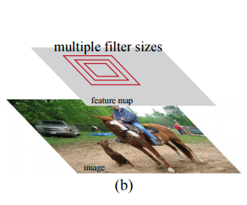
2016: Faster R-CNN - Speeding Up Region Proposal
Different schemes for addressing multiple scales and sizes
(a) Pyramids of images and feature maps are built, and the classifier is run at all scales
(b) Pyramids of filters with multiple scales/sizes are run on the feature map.

Slide 53

Region Proposal Network
‘Attention’ mechanisms, the RPN module tells the Fast R-CNN module where to look.
Slide a small network over the convolutional feature map output by the last shared convolutional layer, with input an n x n spatial window, mapped to a lower-dim feature
This feature is fed into two sibling fully connected layers - a box-regression layer (reg) and a box-classification layer (cls)

Slide 54

Region Proposal Network
At each sliding-window location (center of the window called anchor), we simultaneously predict multiple k region proposals, called anchor boxes, with different sizes and aspect ratios (k=9, 3 sizes and 3 ratios)
For a convolutional feature map of a size W × H (typically ∼2,400), there are W*H*k anchors in total
(c) a pyramid of anchors
The reg layer has 4k outputs encoding the coordinates of k boxes (relative to the anchor), and the cls layer outputs 2k scores that estimate probability of object or not object for each proposal

Slide 55
Faster-RCNN
k anchors boxes
2k scores
4k coordinates
object or not object
bounding box proposal
1x1 conv layer
1x1 conv layer
cls layer
reg layer
nxn conv layer
feature map
sliding window, nxn
…
Region Proposal Networks

Slide 56
Faster-RCNN
RPN
Shared conv layers
Fast-RCNN
Region Proposal Networks

Slide 57
Faster-RCNN
Region Proposal Networks

Slide 58


RPN Loss function
Assigned a binary class label (of being an object or not) to each anchor (highest IoU with a ground-truth box or over a threshold).
Note that a single ground-truth box may assign positive labels to multiple anchors.
The regression loss is activated only for positive anchors (p∗_{i} = 1) and is disabled otherwise (p∗_{i} = 0)

Slide 59
Global training
For the detection network, adopted Fast R-CNN
4-Step Alternating Training:
CNN network is initialized with an ImageNet-pre-trained model, RPN fine-tuned end-to-end for the region proposal task.
train a separate detection network (same on Imagenet) by Fast R-CNN using the proposals generated by the step-1 RPN
use the detector network to initialize RPN training fixing x the shared convolutional layers and only fine-tune the layers unique to RPN
keeping the shared convolutional layers fixed, we fine-tune the unique layers of Fast R-CNN

Slide 60

RCNN vs Fast-RCNN
Figure adapted from: http://cs231n.stanford.edu/slides/2017/cs231n_2017_lecture11.pdf
Notes:
From the above graph, you can see that Faster R-CNN is much faster than it’s predecessors. Therefore, it can even be used for real-time object detection.

Slide 61
RCNN vs Fast-RCNN vs Faster-RCNN
RCNN
Fast-RCNN
Faster-RCNN
Simple and scalable.
improves mAP.
Higher mAP.
Single stage, end-to-end training.
No disk storage is required for feature caching.
Compute proposals with a deep convolutional neural network --Region Proposal Network (RPN)
Merge RPN and Fast R-CNN into a single network, enabling nearly cost-free region proposals.
A multistage pipeline.
Training is expensive in space and time (features are extracted from each region proposal in each image and written into disk).
Object detection is slow.
Proposals are the computational bottleneck in detection systems.
?

Slide 62

Comparison

Slide 63


Object detection with YOLO

Slide 64

YOLO- You Only Look Once
Idea: No bounding
box proposal.
A single regression problem, straight
from image pixels
to bounding box
coordinates and
class probabilities.
extremely fast
reason globally
learn generalizable representations.
https://arxiv.org/abs/1506.02640
Redmon et al. CVPR 2016.

Slide 65

YOLO- You Only Look Once
Divide the image into 7x7 cells.
Each cell trains a detector.
The detector needs to predict the object’s class distributions.
The detector has B bounding-box predictors to predict bounding-boxes and confidence scores.

Slide 66
2016: Yolo – you only look once
Prior work on object detection repurposes classifiers to perform detection.
Object detection as a regression problem to spatially separated bounding boxes and associated class probabilities.
A single neural network predicts bounding boxes and class probabilities directly from full images in one evaluation.
Since the whole detection pipeline is a single network, it can be optimized end-to-end directly on detection performance ~ 45 fps, real time
YOLO sees the entire image during training and test time so it implicitly encodes contextual information about classes as well as their appearance.

Slide 67

2016: Yolo – you only look once

Slide 68


Unified detection
Divides the input image into an S × S grid. If the center of an object falls into a grid cell, that grid cell is responsible for detecting that object.
Each grid cell predicts B bounding boxes (4 predictions, x,y,w,h) and confidence scores for those boxes
Each grid cell also predicts C conditional class probabilities, Pr(Class_{i}|Object), regardless of the number of boxes B.

Slide 69
Unified detection
At test time multiply the conditional class probabilities and the individual box confidence predictions
These scores encode both the probability of that class appearing in the box and how well the predicted box fits the object.
These predictions are encoded as an S × S × (B ∗ 5 + C) tensor.

Slide 70

Loss function
One predictor to be “responsible” for predicting an object based on which prediction has the highest current IOU with the ground truth.
This leads to specialization between the bounding box predictors.
Each predictor gets better at predicting certain sizes, aspect ratios, or classes of object, improving overall recall.
where 1^{obj} _{i} denotes if object appears in cell i and 1^{obj}_{ij} denotes that the j-th bounding box predictor in cell i is “responsible” for that prediction.
Notes:
Useful explanation: https://stats.stackexchange.com/a/287497

Slide 71

Net design and training/problems
Pretrain first 20 convolutional layers on the ImageNet 1000-class competition dataset.
Add four convolutional layers and two fully connected layers with randomly initialized weights.
Optimize sum-squared error, but it weights localization error equally with classification error which may not be ideal => introduced parameters to weight.

Slide 72
Net design and training/problems
Many grid cells do not contain any object pushing the “confidence” scores of those cells towards zero, often overpowering the gradient from cells that do contain object
Equally weights errors in large boxes and small boxes.
Metric should reflect that small deviations in large boxes matter less than in small boxes.

Slide 73

2016: Yolo – you only look once
YOLO learns generalizable representations of objects.
When trained on natural images and tested on artwork, YOLO outperforms top detection methods

Slide 74
Limitations of YOLO
Each grid cell only predicts B boxes and can only have one class (limits the number of nearby objects that model can predict)
it struggles to generalize to objects in new or unusual aspect ratios or configurations
loss function treats errors the same in small bounding boxes versus large bounding boxes (partially addressed using square roots).

Slide 75

Real-Time Detection In The Wild
Possible to connect YOLO to a webcam and verify that it maintains real-time performance.
While YOLO processes images individually, when attached to a webcam, it acts like a tracking system, detecting objects as they move around and change in appearance.
https://pjreddie.com/darknet/yolo/

Slide 76

2017: yolov2 -YOLO9000: Better, Faster, Stronger
The original YOLO trains the classifier network at 224 × 224 on Imagenet and increases the resolution to 448 for detection.
YOLOv2 first finetunes the classification network at the full 448 × 448 resolution for 10 epochs on ImageNet.
This gives the network time to adjust its filters to work better on higher resolution input.

Slide 77
Many more versions…
Yolo
Yolov2
Yolov3
Yolov4
Yolov5
Yolov6
Yolov7
YoloX
YoloS
YoloF
YoloR
…

Slide 78

Most influential Googgle scholar papers 2021

Slide 79

SSD: Single Shot Detector
Idea: Similar to YOLO, but denser grid map, multiscale grid
maps.
+ Data augmentation
+ Hard negative mining
Liu et al. ECCV 2016.
Notes:
Ok, so you have positives and negatives, so you train a classifier, and to test it out, you run it on your training images again with a sliding window. But it turns out that your classifier isn't very good, because it throws a bunch of false positives (people detected where there aren't actually people).
A hard negative is when you take that falsely detected patch, and explicitly create a negative example out of that patch, and add that negative to your training set. When you retrain your classifier, it should perform better with this extra knowledge, and not make as many false positives.

Slide 80

2016: Single Shot Multibox detector
The early network layers are based on a standard architecture (VGG) used for high quality image classification
add convolutional feature layers to the end of the truncated base network, which decreases in size progressively and
allow predictions of detections at multiple scales.
Liu, Wei, et al. "Ssd: Single shot multibox detector." European conference on computer vision. Springer, Cham, 2016.

Slide 81
Multi-scale feature maps for detection
In a convolutional fashion, evaluate a small set (e.g. 4) of default boxes of different aspect ratios at each location in several feature maps with different scales
For each default box, predict both the shape offsets and the confidences for all object categories
This results in a total of (c + 4)k filters (k default boxes) that are applied around each location in the feature map, yielding (c + 4)kmn outputs for a m × n feature map

Slide 82

Multi-scale feature maps for detection
Default boxes are similar to the anchor boxes used in Faster R-CNN, but applied to several feature maps of different resolutions.
Allowing different default box shapes in several feature maps let us efficiently discretize the space of possible output box shapes.

Slide 83
Matching strategy
Key difference between training SSD and training a typical detector that uses region proposals, is that ground truth information needs to be assigned to specific outputs in the fixed set of detector outputs:
- need to determine which default boxes correspond to a ground truth detection and train the network accordingly.
Some version of this is also required for training in YOLO and for the region proposal stage of Faster R-CNN.

Slide 84

Matching strategy
Matched each ground truth box to the default box with the best Jaccard overlap,
then match default boxes to any ground truth with Jaccard overlap higher than a threshold (0.5).
This simplifies the learning problem, allowing the network to predict high scores for multiple overlapping default boxes rather than requiring it to pick only the one with maximum overlap.
The overall objective loss function is a weighted sum of the localization loss (loc) and the confidence loss (conf):
Notes:
class-agnostic during the matching step

Slide 85
Hard Negative Mining in Object Detection
Imbalance Issue: Excessive negative predictions compared to actual objects.
SSD's Approach: Sorts negatives by confidence loss and selects those with the highest loss.
Balanced Ratio: Maintains a maximum 3:1 ratio of negatives to positives.
Outcome: Enhances training speed and stability.

Slide 86

Cons
SSD is very sensitive to the bounding box size.
- In other words, it has much worse performance on smaller objects than bigger objects.
- This is not surprising because those small objects may not even have any information at the very top layers

Slide 87

Comparison on VOC’2007
PASCAL VOC 2007 and 2012 data sets consist of 20 categories. The evaluation terms
are AP in each single category and mAP across all the 20 categories.
Zhao, Z. Q., Zheng, P., Xu, S. T., & Wu, X. (2019). Object detection with deep learning: A review. IEEE transactions on neural networks and learning systems, 30(11), 3212-3232.

Slide 88

Comparison on VOC’2012
Zhao, Z. Q., Zheng, P., Xu, S. T., & Wu, X. (2019). Object detection with deep learning: A review. IEEE transactions on neural networks and learning systems, 30(11), 3212-3232.

Slide 89
Results on VOC’07 and VOC’12
1) If incorporated with a proper way, more powerful backbone CNN models can definitely improve the object detection performance (the comparison among R-CNN with AlexNet vs R-CNN with VGG16).
2) With the introduction of the end-to-end multitask architecture (FRCN), and RPN (Faster R-CNN), object detection performance is improved gradually and apparently.
3) Due to a large number of trainable parameters, in order to obtain multilevel robust features, data augmentation is very important for deep learning-based models (Faster R-CNN).
4) Apart from basic models, there are still many other factors affecting object detection performance,
such as multiscale and multi-region feature extraction, modified classification networks, additional information from other correlated tasks, multiscale representation, and mining of hard negative samples.
5) As YOLO is not skilled in producing object localizations of high IoU, it obtains a very poor result on VOC 2012.
However, with the complementary information from Fast R-CNN (YOLO+FRCN), anchor boxes, BN, and fine-grained features, the localization errors are corrected (YOLOv2).

Slide 90

Comparison on Microsoft COCO
Microsoft COCO is composed of 300 000 fully segmented images, in which each image has an average of 7 object instances from a total of 80 categories.
As there are a lot of less iconic objects with a broad range of scales and a stricter requirement on object localization, this data set is more challenging than PASCAL 2012.
Object detection performance is evaluated by AP computed under different degrees of IoUs and on different object sizes.

Slide 91

Conclusions
1) By computing CNN features on shared feature maps, test consumption is reduced largely.
Test time is further reduced with the unified multitask learning (FRCN) and removal of additional region proposal generation stage (Faster R-CNN).
2) It takes additional test time to extract multiscale features and contextual information (Mask-RCNN).
3) It takes more time to train a more complex and deeper network (ResNet101 against VGG16) and this time consumption can be reduced by adding as many layers into shared fully convolutional layers as possible (FRCN).
4) Regression-based models can usually be processed in real time at the cost of a drop in accuracy compared with region proposal-based models.
Also, region proposal-based models can be modified into real-time systems with the introduction of other tricks, such as Batch-Normalisation and residual connections.
5) Thanks to the usage of transformers, DETR has a simpler architecture and does not need post-processing on the outputs.
Carion, Nicolas, et al. "End-to-end object detection with transformers." European conference on computer vision. Cham: Springer International Publishing, 2020

